Slide 1

Notes:
[ANNOUNCEMENT: MY CHURCH APP]
We have two messages left in our Sermon on the Mount series, a 17-week series which began last fall. In Matthew 5-7, Jesus proclaims the good news of the Kingdom of God and casts a vision of what it looks like to live in right relationship with God, our neighbors, and our enemies. And he essentially says, if you want to be my disciple, you have to take seriously the words that are coming out of my mouth.
We have learned in this series that the Sermon on the Mount contains the core of Jesus’ teachings and his most well-known sayings, including some of the most rigorous ethical demands in the Bible. And if we call ourselves “Christians”—or you’re still trying to decide what you think about Jesus and the Christian faith—please understand that Jesus intends his followers to put his words into practice as individuals and as a faith community, bearing witness to who he is and to the gospel of God’s coming Kingdom.
My friends, Jesus shows us the good life and what it looks like to seek the Kingdom and keep to the road which leads to life. Despite what we may see from many evangelical Christians today, the Sermon on the Mount is at the heart of what it means to follow Jesus; it’s the litmus test and the standard by which we can discern who is serious about following Jesus, and who is just using Jesus as an add-on to support their brand of American civic religion. For those folks, the real Jesus has been replaced by an idol: the nation-state. And when this idol replaces Jesus, we then use Jesus as a cheerleader to promote our desired socio-economic and political culture in this worldly kingdom in which we live. This is not true Christian faith. And Jesus is going to warn us today about following those who lead us off the narrow path.
We are now entering the final section of the Sermon on the Mount… [NEXT SLIDE]

Slide 2
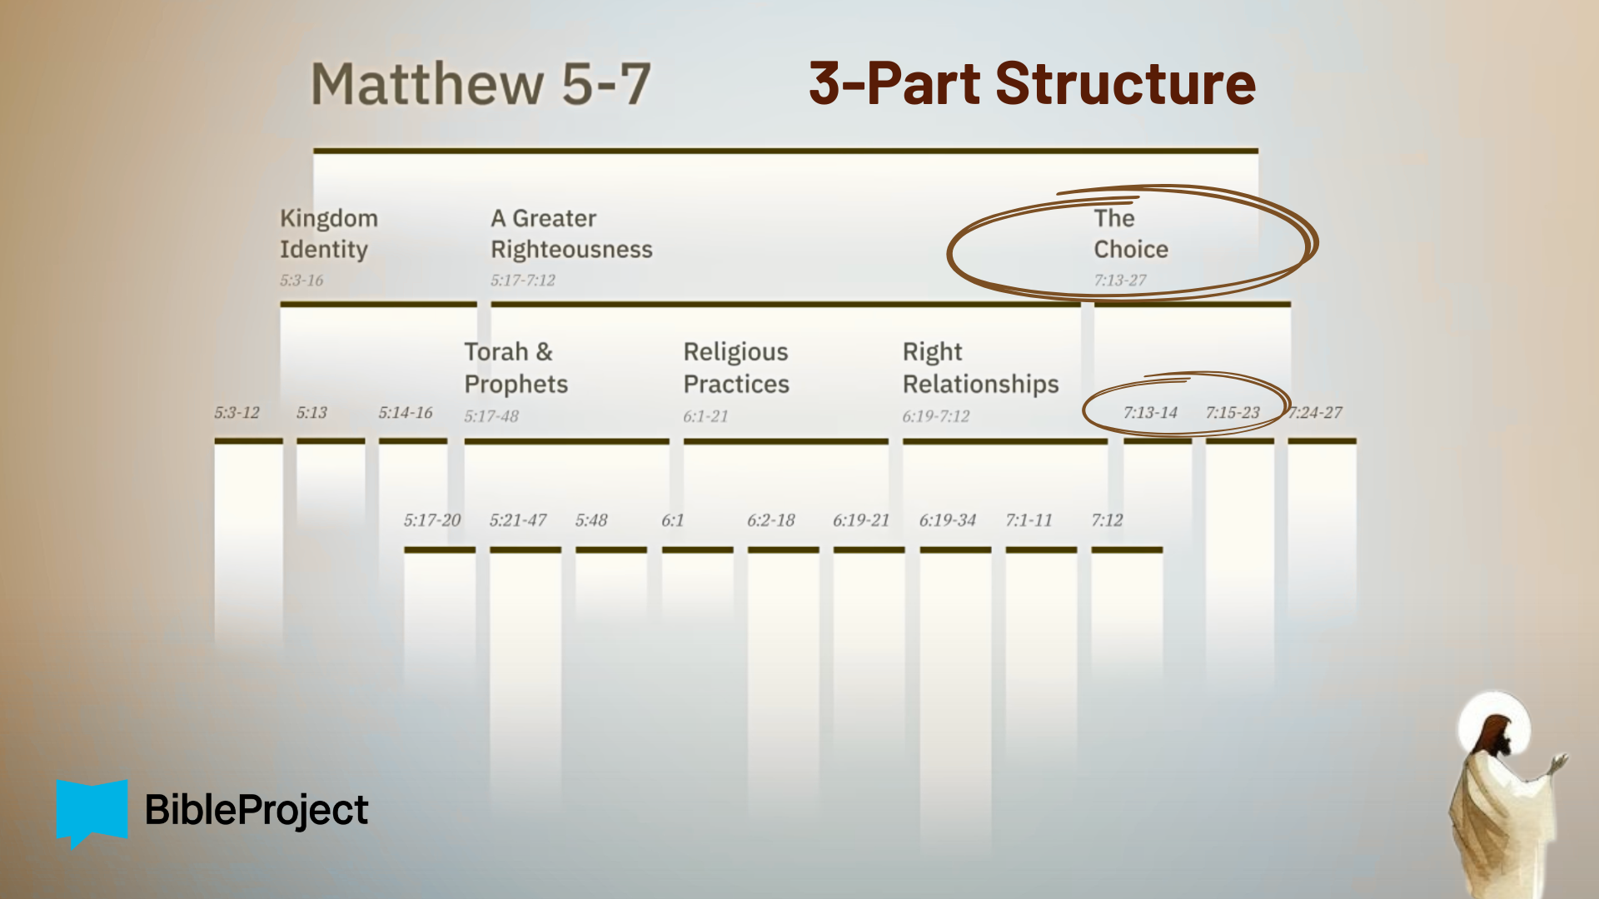
Notes:
…where Jesus wraps up his sermon by presenting us with a choice about whether we will follow his teachings, seek the Kingdom, and work toward a “greater righteousness”, or not. Using several examples and metaphors (two roads, two trees, and two houses), the Lord invites us to choose how we will respond.
If you’re taking notes, I’ve entitled today’s message… [NEXT SLIDE]

Slide 3

Notes:
Wolves in Sheep’s Clothing. This morning we’re going to hear Jesus warn his followers to watch out for false prophets and leaders who appear harmless but lead people off the narrow road that leads to life. And we’re also going to hear how we can tell the difference in good and bad leaders and influencers, as we’re reminded of the importance of doing the real work of character formation, so that we’re not just busy doing religious stuff for God and end up forfeiting our Kingdom inheritance in the process.
Once again, pray with me before we begin: Father, may the words of my mouth and the meditation of my heart be acceptable in your sight, O LORD, my Rock and my Redeemer. We give this time of “Hearing the Word” to you. We ask that you speak words of comfort, of conviction, of challenge, and of assurance. Free us from our bondage. Remove the scales from our eyes. We pray against our real enemy who seeks to steal, kill, and destroy, and blind the minds of unbelievers. Jesus, illuminate our hearts and minds with your light. Holy Spirit, help us to receive the words of God and empower us to live according to the teachings of our Lord. For it’s in his name we pray. Amen.
Would you open your Bibles to our main Scripture reading… [NEXT SLIDE]

Slide 4
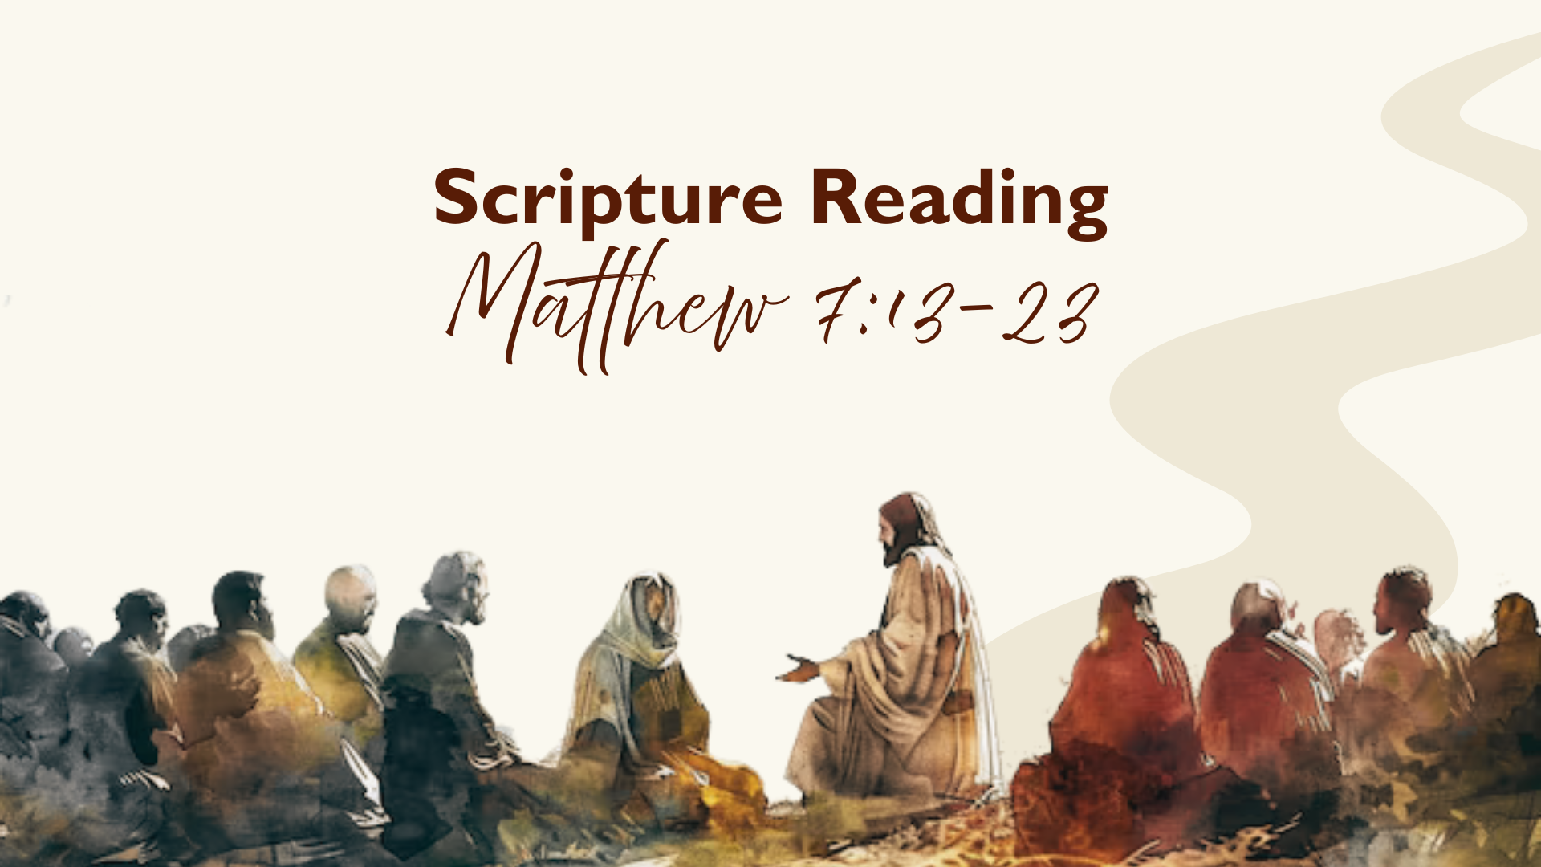
Notes:
Matthew 7:13-23. [INVITATION TO STAND FOR SCRIPTURE READING]
*You’ll notice that we’re beginning with verses 13 and 14
[READ SCRIPTURE] This is the word of the Lord. Thanks be to God. You may be seated.
Several years ago, wildlife officials in Yellowstone noticed something strange. A group of sheep ranchers kept reporting losses, but no one could find the predator responsible. There were no clear tracks, no obvious signs of attack. Eventually, they discovered that a wolf had learned to stay close to the herd, move quietly among the sheep, and strike when no one was watching. From a distance, everything looked peaceful — until the damage was done.
Jesus says spiritual danger often works the same way. It rarely announces itself. It blends in, sounds familiar, and looks harmless — until it begins pulling people away from the life God intends. And that’s what Jesus warns us about in today’s Scripture focus, and what he wants us to be on guard against in the church. So let’s go verse-by-verse and unpack what we just read… [NEXT SLIDE]

Slide 5

Notes:
Notice, Jesus begins The Choice with two roads, and now he is going to tell us that people will come, and, like wolves in sheep’s clothing, attempt to lead you off the narrow path set before us in his sermon. Their appetite is their flesh, and their goal is to use you for their purposes, ultimately devouring your faith.
[READ VERSE-BY-VERSE & COMMENT]
v. 15a – “Watch out” or “Beware” or “Pay Attention” Jesus says, for “false prophets” (Gk: pseudo-prophets) – prophets are authority figures, who, in this case, represent or claim to speak for God; false prophets are a problem all throughout the Bible (e.g., in Ezekiel 13:1-16 they speak ”out of their own imagination” and from “their own spirit” (not God’s); they tell lies; false prophets tell people want they want to hear; they cover the cracks in the wall with paint; they do not speak the truth about God or what God wants; and they do all of this while convincing people that they can be trusted to lead you down a good path.
That’s why Jesus says… [READ v.15b]
So, get this image that Jesus is evoking… [NEXT SLIDE]

Slide 6
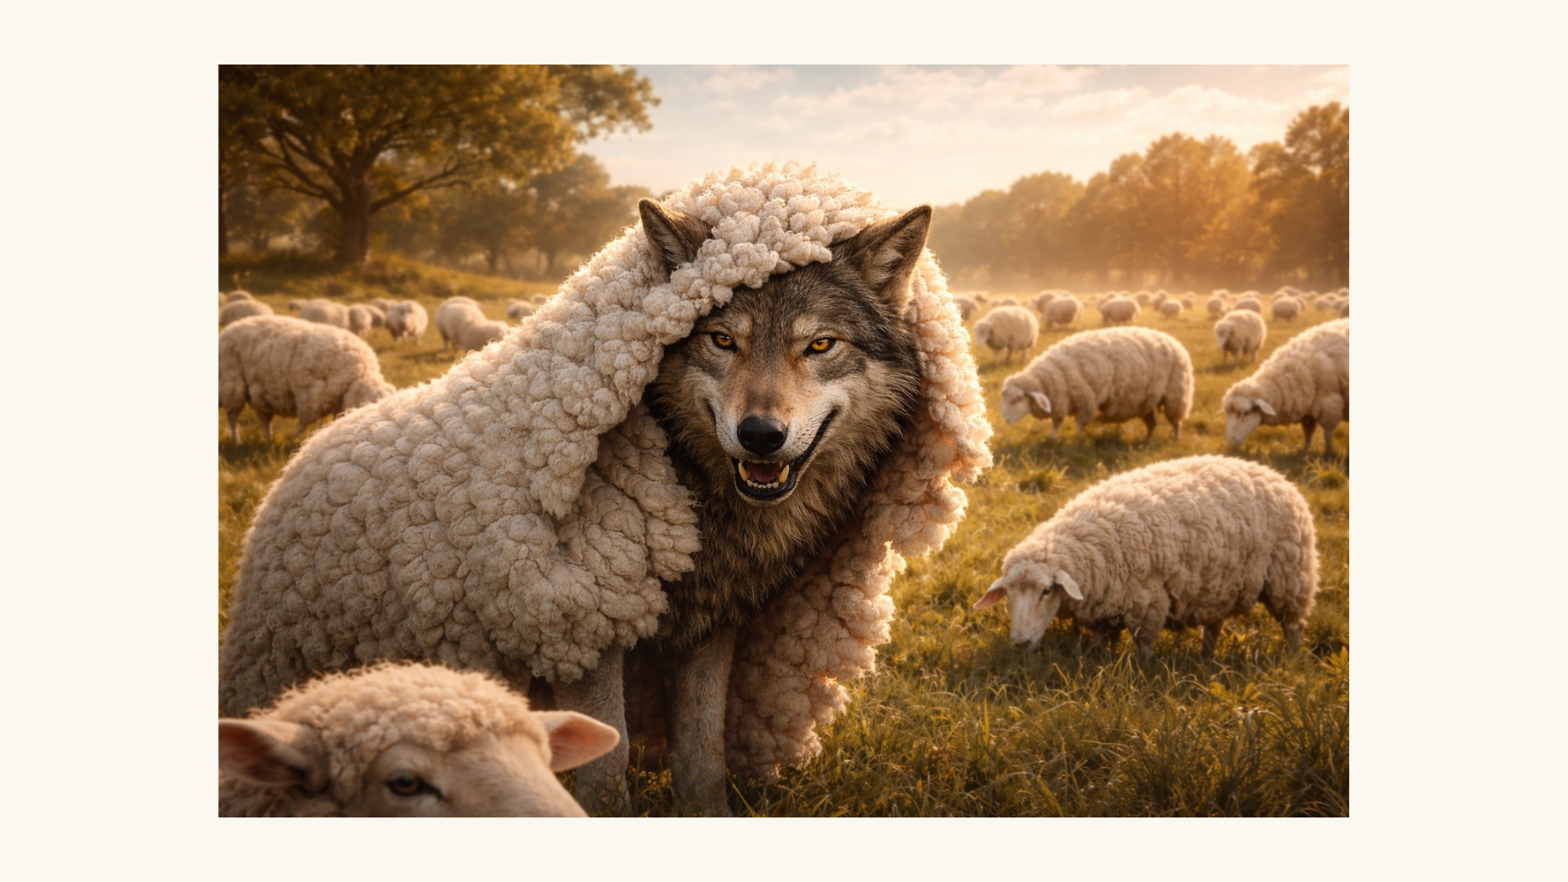
Notes:
“They come to you in sheep’s clothing, but inwardly they are ferocious wolves.”
It’s a comical but also frightening image, isn’t it?—a wolf in sheep’s clothing. For what purpose? Well, to convince you that they are one of you; that they can be trusted; that they speak for you and will protect you. But as soon as you start to doubt and question… saying… ”Grandma, what big ears you have. What’s with those ears? Grandma, what big eyes you have. What’s with those eyes? And grandma, what big teeth you have. What’s with those teeth?” Well, get ready. Because you’re about to be ”Grandma’s” lunch.
And you’re thinking, “Oh my, that’s a unpleasant thing to think about. How will we know who this ”false prophet” is in our midst? Can we know?” Well, listen to what Jesus says in verse 16… [NEXT SLIDE]

Slide 7
Notes:
[READ VERSES 16-20 & COMMENT]
”fruit” – outward signs, words, deeds, and behavior revealing who they really are underneath
What does Jesus mean by the two trees imagery? There are actually a couple ways to hear and understand what Jesus is communicating… [NEXT SLIDE]

Slide 8
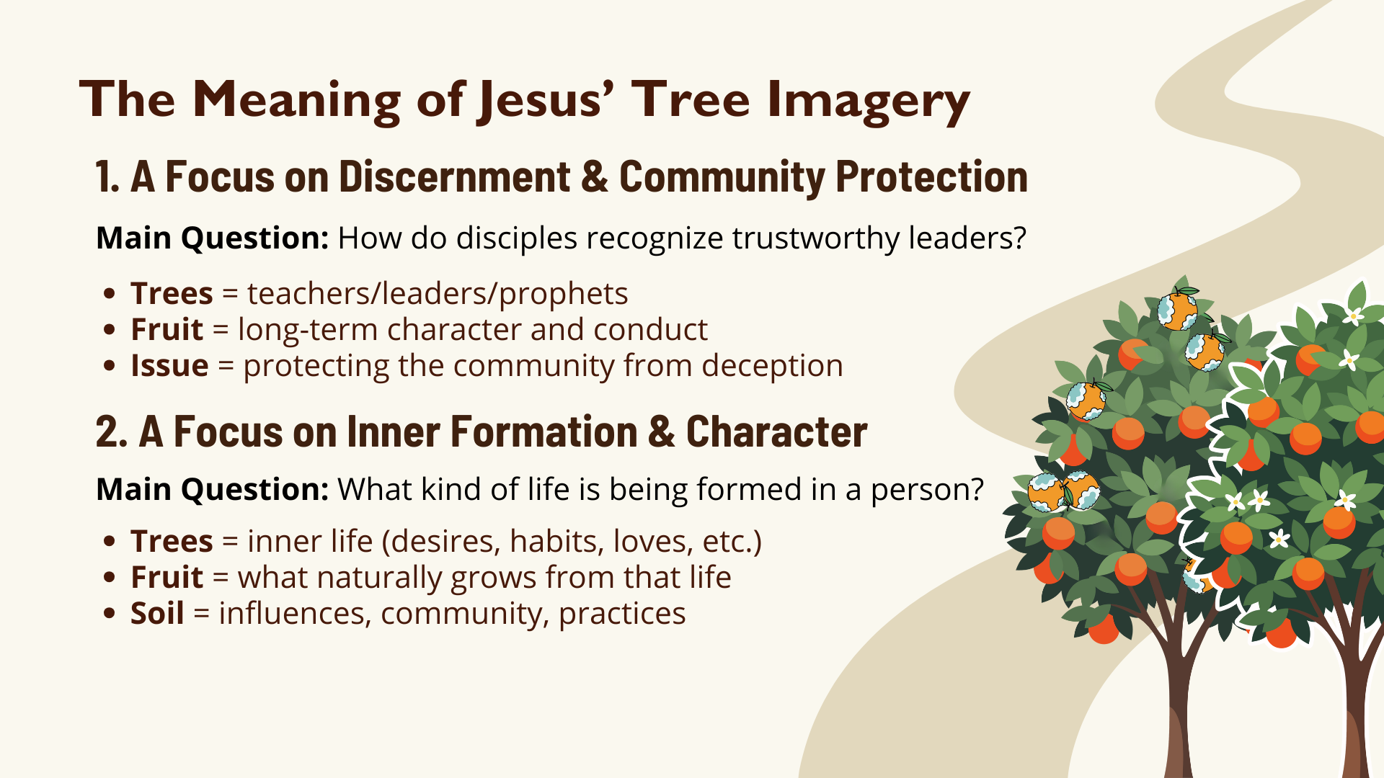
Notes:
[READ SLIDE & COMMENT]
This applies to pastors, politicians, CEOs, podcasters, and YouTube influencers
So, lets dig down even deeper now and ask, “What does bad fruit in a false prophet, leader, or influencer look like? What are the signs of rotten leadership and character? [NEXT SLIDE]

Slide 9
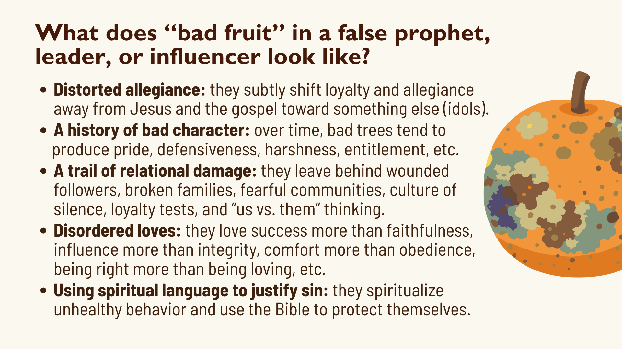
Notes:
[READ & COMMENT ON EACH POINT]
Distorted allegiance: they subtly shift loyalty and allegiance away from Jesus and the gospel toward something else (idols). This “something else” might be: power, money, political identity, personal brand, ideology, control, or spiritual status. They may use Jesus-language, but Jesus is no longer the center.
A history of bad character: over time, bad trees tend to produce pride, defensiveness, harshness, entitlement, etc. pride instead of humility, defensiveness instead of teachability, harshness instead of gentleness, manipulation instead of honesty, entitlement instead of service. They resist correction. They protect their image. They blame others. Folks, this contradicts the way of Jesus.
A trail of relational damage: they leave behind wounded followers, broken families, fearful communities, a culture of silence, loyalty tests, and “us vs. them” thinking. Even if crowds grow, under their leadership and influence, love shrinks. Jesus’ way always produces healing, reconciliation, and maturity — even through hardship. True prophets and healthy leaders will genuinely care about people.
Disordered loves: sin starts with misdirected desires. These people love success more than faithfulness, influence more than integrity, comfort more than obedience, being right more than being loving. And these disordered loves eventually shape their ideas, teaching, and leadership. And the fact of the matter is… you can’t keep loving the wrong things and still produce Kingdom fruit.
Using spiritual language to justify sin: they spiritualize unhealthy behavior and use the Bible to protect themselves. For example, they may say something like: “God told me…” (to avoid accountability); “Don’t touch the Lord’s anointed” (to silence questions); “You lack faith” (to blame victims); They may say, “This is just bold leadership” or “I was just being honest" (to excuse cruelty). They use Scripture to protect themselves, not to serve others.
So, instead of only asking: “Is this prophet, politician, pastor, teacher, influencer ever wrong?” Ask: “What kind of disciples are being produced? What sort of community are they forming?” Because the truth is that good trees produce people who are becoming: more loving, more honest, more patient, more generous, more faithful, and more Christlike. But bad trees produce people who are becoming anxious, angry, tribal, obsessed with enemies, cynical, and self-righteous. So, what kind of tree is it? Well, just look at the fruit in the followers.
But to be clear, Jesus is not calling us to be suspicious critics. We don’t need more cynic saints. Instead, we need wise disciples who are coming to know the genuine article so we can spot the counterfeit. We need wise disciples who can discern these things together in community… [NEXT SLIDE]

Slide 10
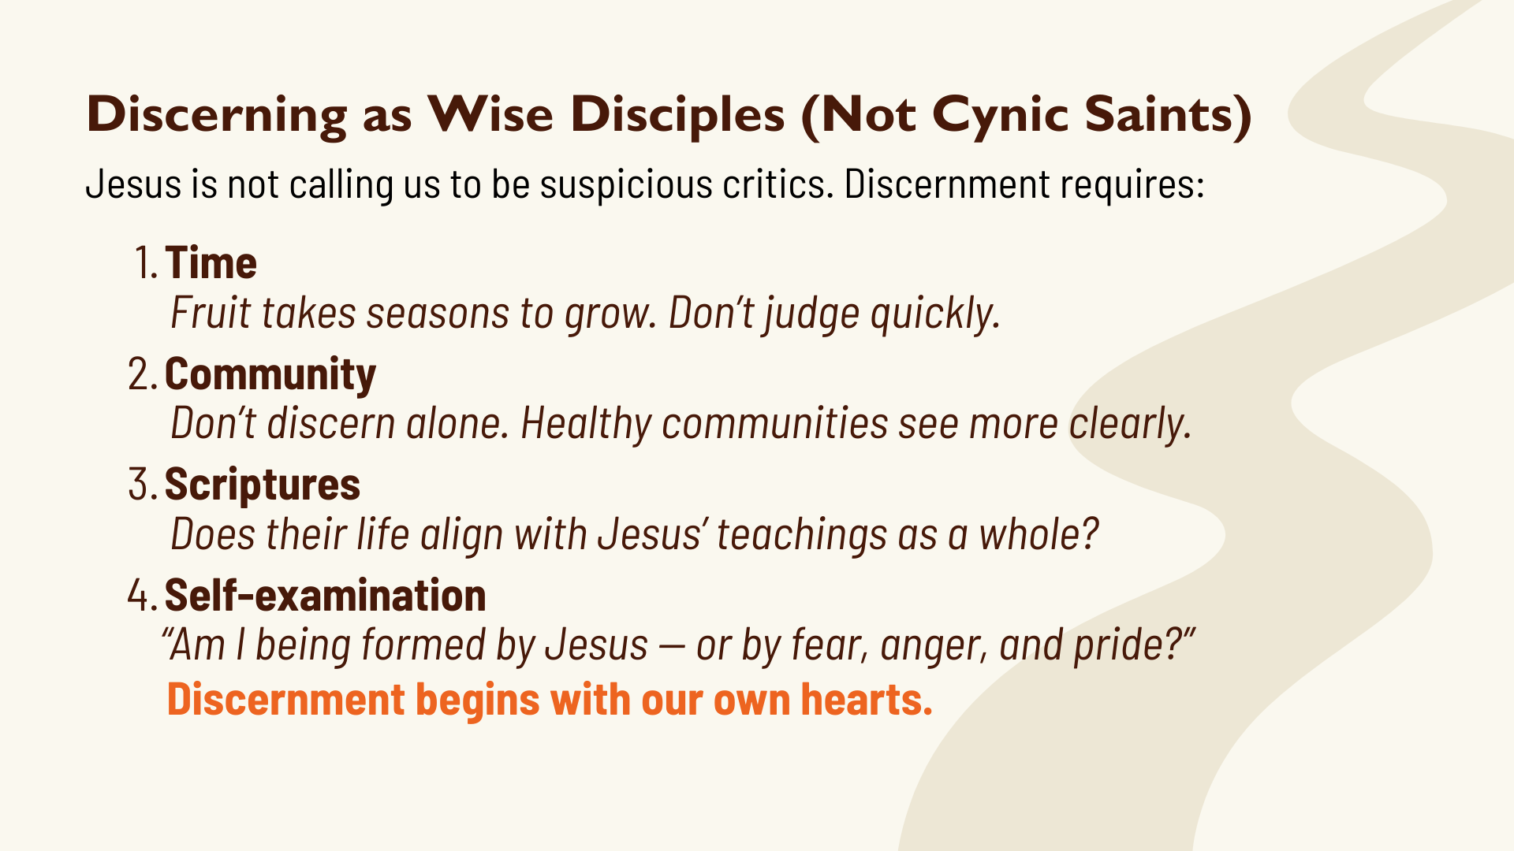
Notes:
Time: Fruit takes seasons to grow. Don’t judge quickly. A bad tree is not someone who struggles — it is someone whose life and influence consistently form people away from the character and way of Jesus. And false prophets are revealed less by what they say and more by what their lives and communities produce over time.
Community: Don’t discern alone. Healthy communities see more clearly. This is why we shouldn’t gravitate toward our cliques and echo chambers. We need each other. We need to listen to one another. We need to pray, search the Scriptures, and discern together. 1 John 4:1 tells us to “test the spirits” to see if a person is of Christ or not.
Scriptures: Does their life align with Jesus’ teachings as a whole? If it doesn’t, ask yourself: “Why am I following them?" And if it’s a politician or influencer, rather than a religious leader in the church, ask yourself, “Why would I support someone whose moral compass is broken and lacks the most basic moral framework to be truthful, kind, and a person of integrity?”
Self-examination: We must begin with self-reflection and ask ourselves: “Am I being formed by Jesus — or by fear, anger, and pride?” And folks, no matter your doctrine or politics, we are all susceptible to this. Therefore, we’ve got to look in the mirror because discernment begins within our own hearts.
Back to Matthew 7, verse 21… [NEXT SLIDE]

Slide 11
Notes:
[READ VERSE-BY-VERSE & COMMENT]
v. 21 – “Lord, Lord” – notice, you can confess “I’m a Christian”; you can say you recognize his authority; you can speak with apparent devotion; but if your life doesn’t line up with God’s will in the teachings of Jesus, then your confession is empty. Do you love the Master, or just the benefits?
v. 22 – you can be proud of your spiritual achievements and outward works of religion; maybe you’ve even been recognized by others for your service, but these are not substitutes for obedience; you see, these false disciples focused on their gifts instead of character, success instead of faithfulness, and ministry instead of holiness. God’s will isn’t shaping their everyday lives; adopting the heart of Jesus and becoming like him in wisdom and character wasn’t their concern.
v. 23 – I never “knew” you. “Knowing” is covenant language from the OT. It means: relational intimacy, loyalty, and mutual belonging. When Jesus says, “I never knew you,” he is saying: You were never living in right relationship with me, regardless of what you did to/for your neighbor. So, don’t miss this… they worked for Jesus, but they did not walk with Jesus. For if they had walked with Jesus, they would have let him transform their heart, attitude, and character. They would have accepted his Lordship.
In short, church, you cannot separate teaching from living. You cannot separate message, beliefs, political positions, and doctrinal stances from a person’s character. False prophets, teachers, leaders, and influencers may sound right (you may even agree with a lot of their ideas), but their “fruit” — pride, greed, manipulation, injustice, lack of love — will eventually expose them for who they really are. And if we’re not careful, we can allow our own faith to be negatively influenced by these wolves in sheep’s clothing.
Again, this is why moral, spiritual, and character formation is so important. Are we becoming like Christ—the true human—or not? Are we bearing fruit, or not? Listen to what Jesus said in John 15… [NEXT SLIDE]

Slide 12
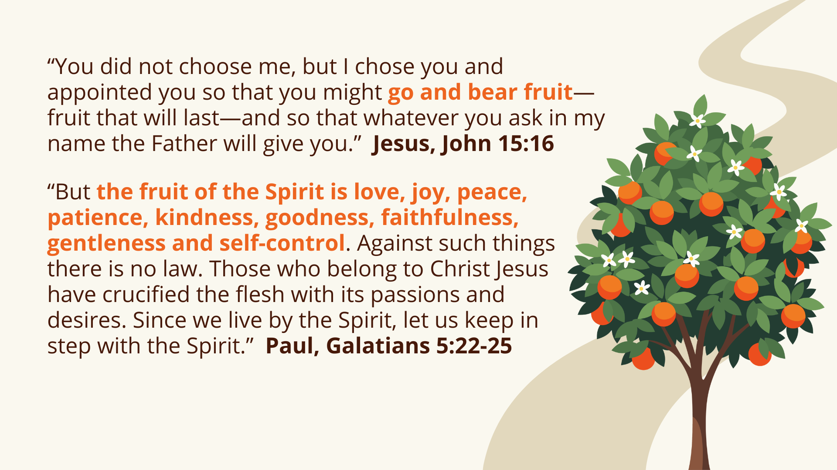
Notes:
[READ PASSAGES & COMMENT]
John 15:16 – fruit that lasts is a changed heart and a transformed mind; fitted for eternity
Galatians 5:22-25 – are you growing in love, joy, peace, patience, kindness, goodness, faithfulness, gentleness, and self-control? Are you living by the flesh or by the Spirit?
I’ve had the honor of walking alongside and mentoring several young men over as many years and let me tell you that I have recently experienced so much joy getting to see these young disciples bear the fruit of the Spirit and see the Lord transform their hearts, their minds, and their character.
Seth Derliunas is one of those young men… [SETH’S STORY]
Real quick… let’s sum of the message with some takeaways… [NEXT SLIDE]

Slide 13
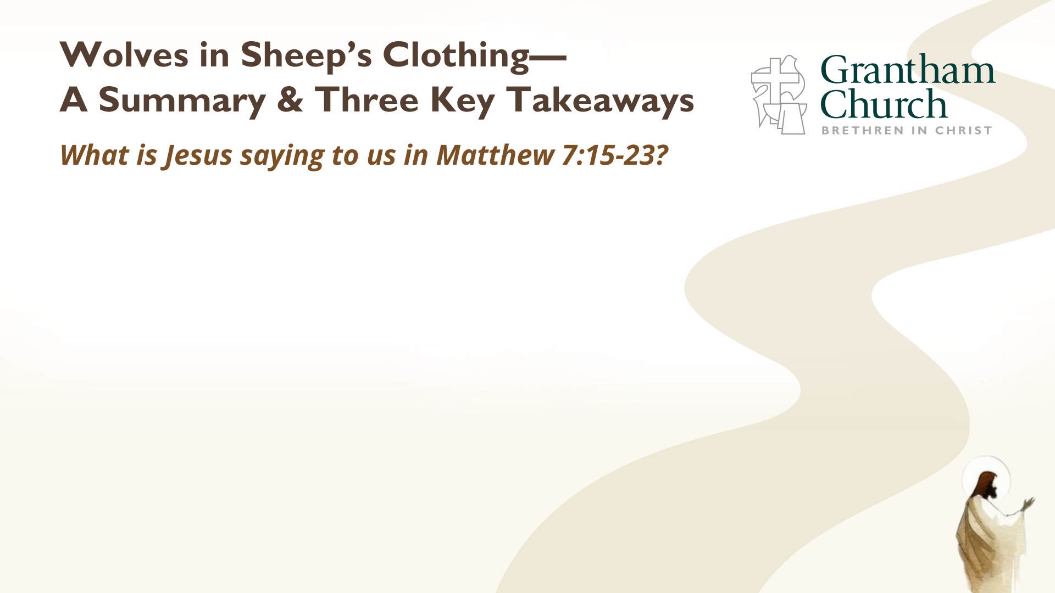

Slide 14
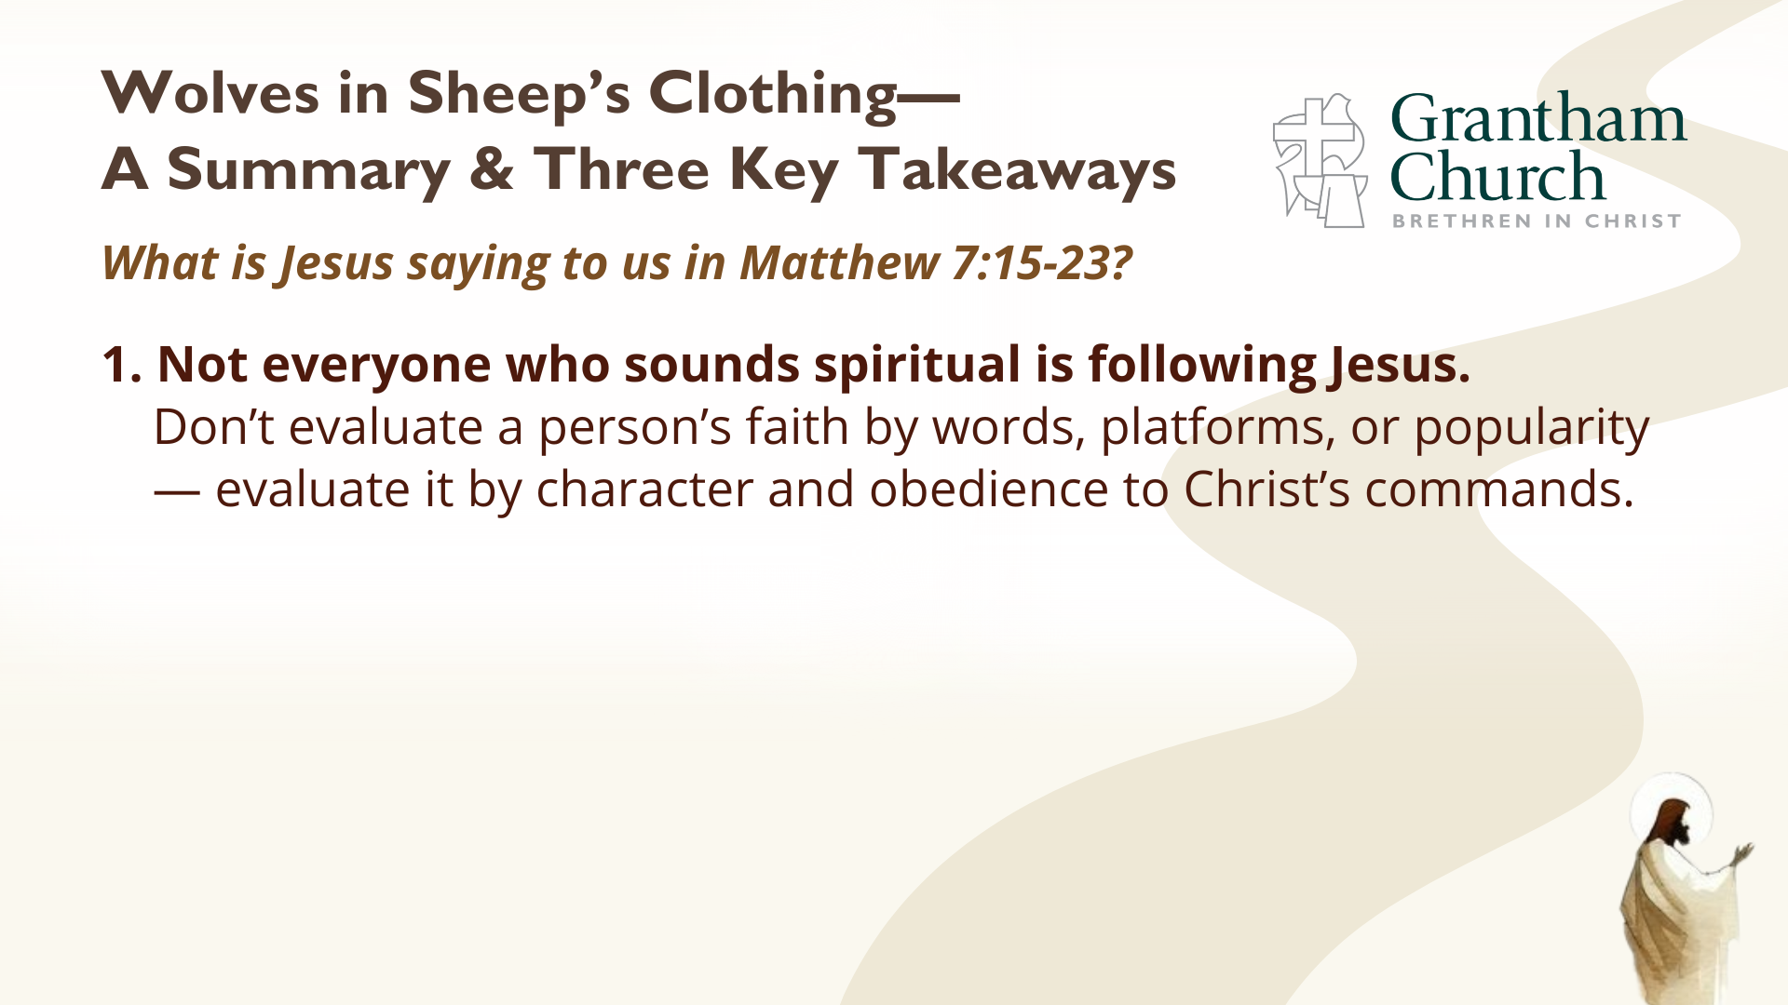

Slide 15
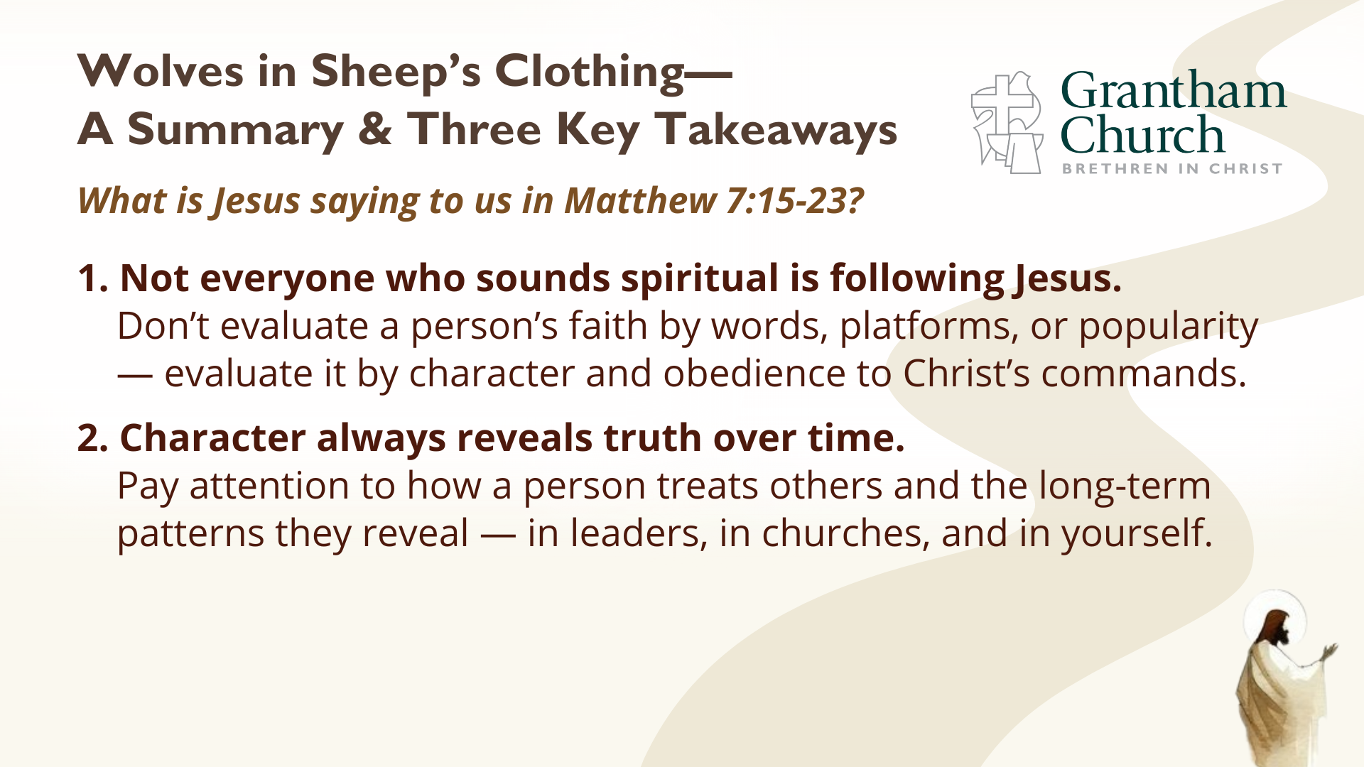
Notes:
[BRIEF COMMENTS]
Finally, here are some questions to help us reflect on what we’ve heard and respond to the promptings of the Spirit… [NEXT SLIDE]

Slide 16
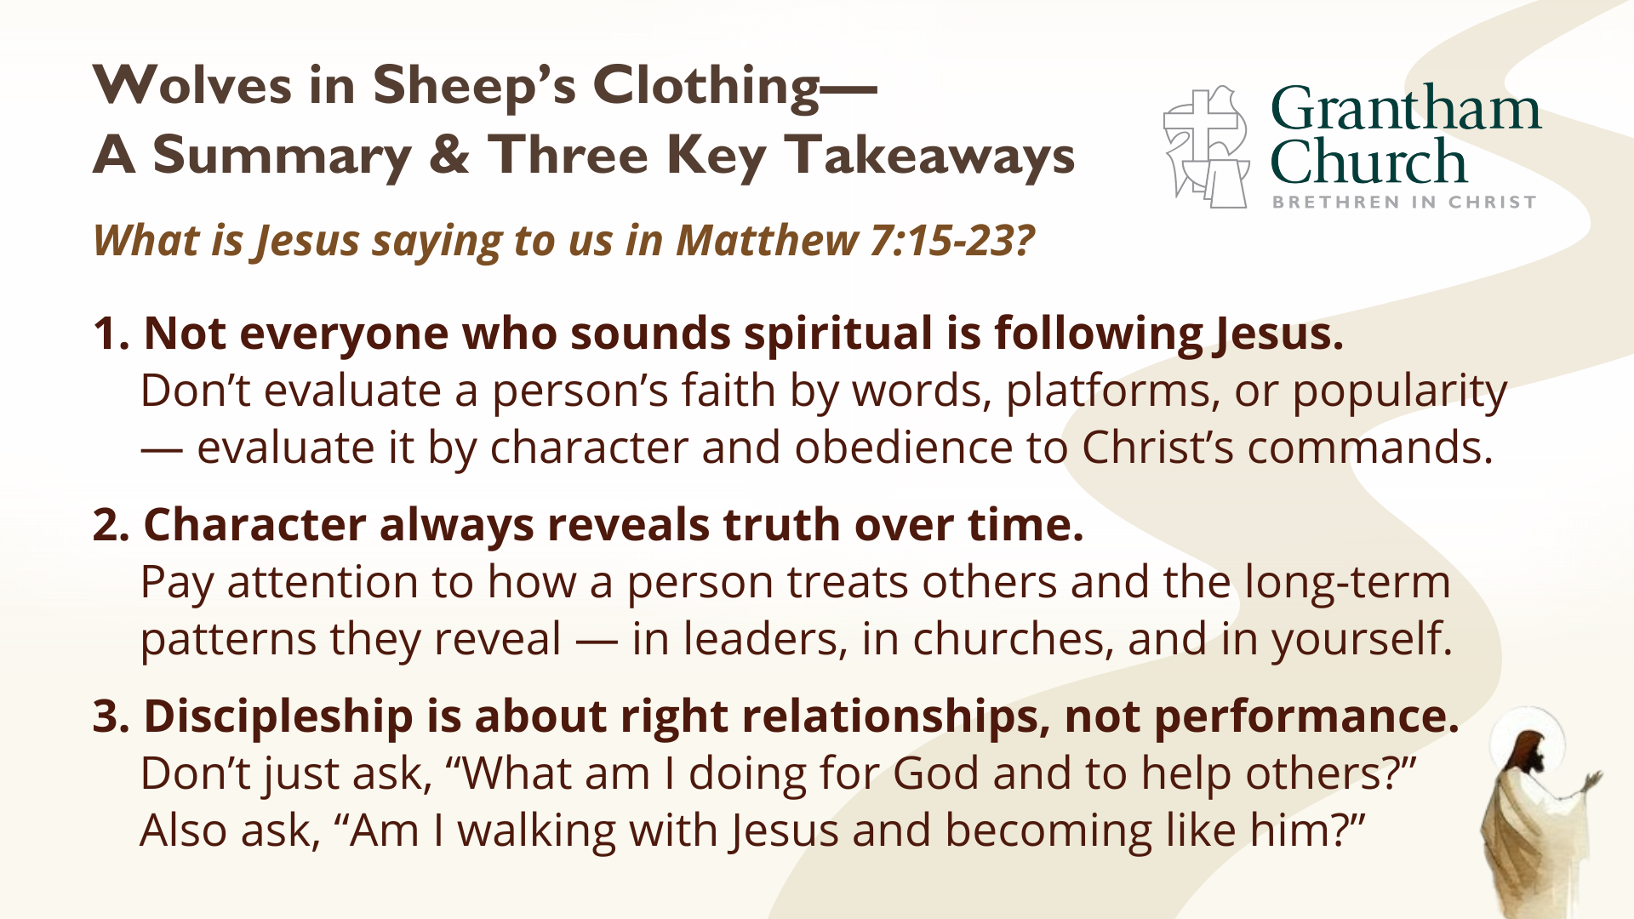
Notes:
[READ & BRIEF COMMENT ON EACH]
1. Not everyone who sounds spiritual is following Jesus.
Don’t evaluate a person’s faith by words, platforms, or popularity
— evaluate it by character and obedience to Christ’s commands.
2. Character always reveals truth over time.
Pay attention to how a person treats others and the long-term
patterns they reveal — in leaders, in churches, and in yourself.
3. Discipleship is about right relationships, not performance.
Don’t just ask, “What am I doing for God and to help others?”
Also ask, “Am I walking with Jesus and becoming like him?”
Finally, here are some questions to help us reflect on what we’ve heard and respond to the promptings of the Spirit… [NEXT SLIDE]

Slide 17


Slide 18
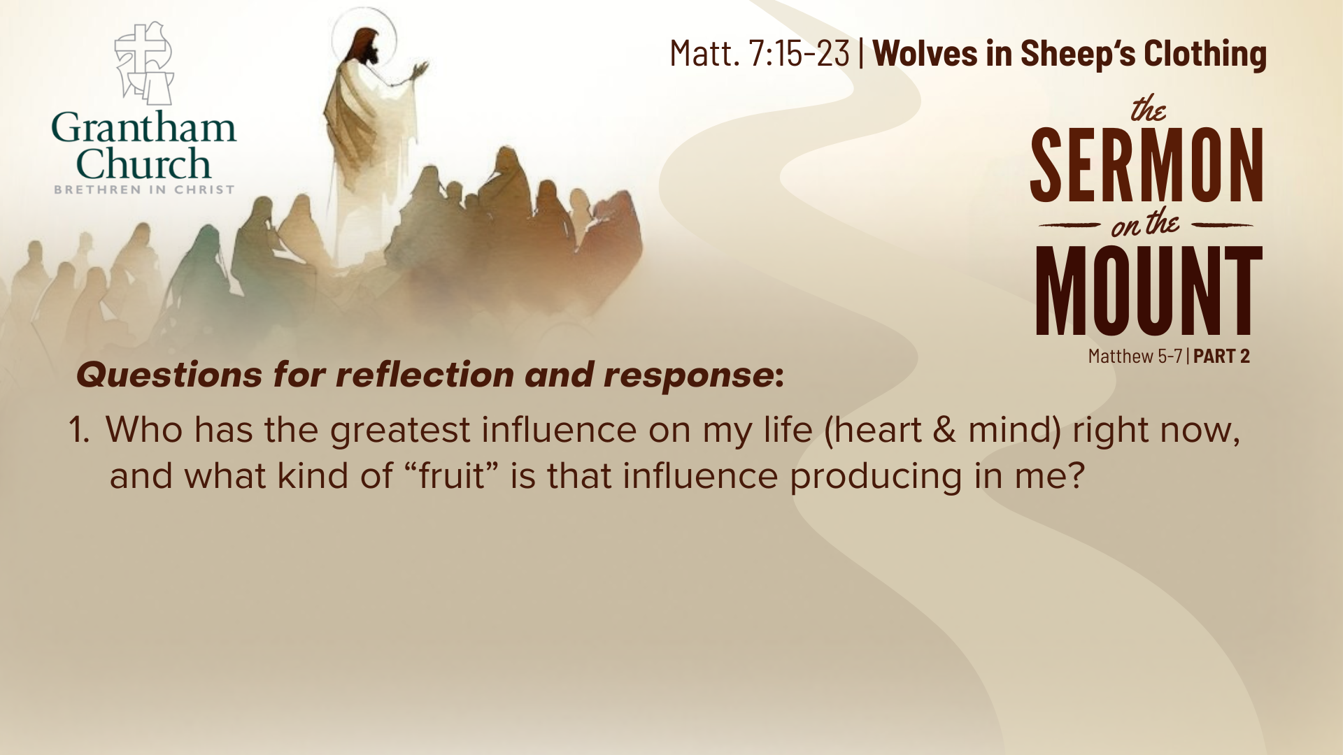

Slide 19
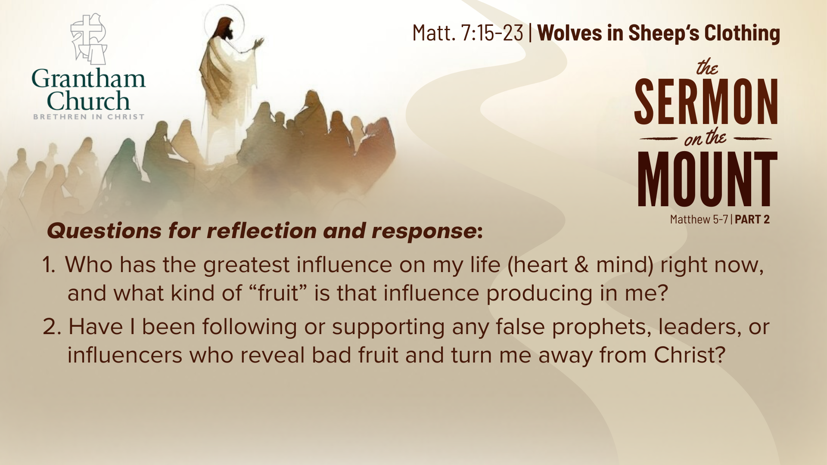

Slide 20
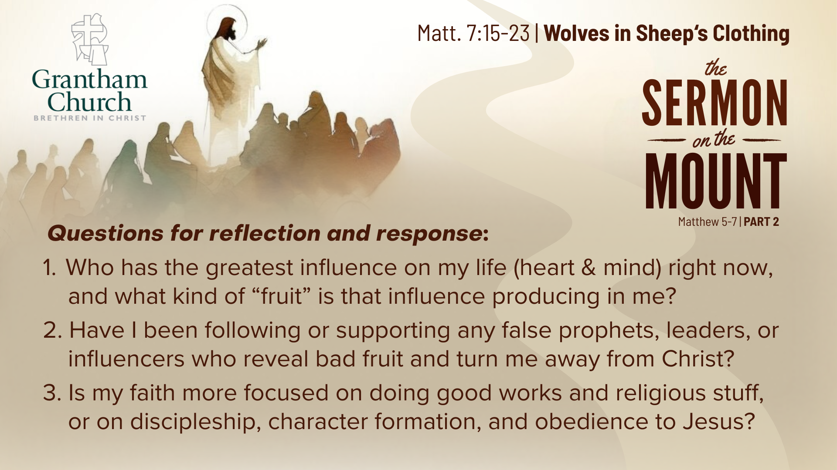
Notes:
[READ EACH QUESTION & COMMENT]
Who has the greatest influence on my life (on my heart & mind) right now, and what kind of “fruit” is that influence producing in me? Be honest. Am I becoming more loving, humble, and faithful — or more anxious, angry, and judgmental?
Have I been following or supporting any false prophets, leaders, or influencers who consistently reveal bad fruit and turn me away from Christ? Who comes to mind? What is the Lord saying to you?
Is my faith more focused on doing good works and religious stuff, or on discipleship, character formation, and obedience to Jesus? Brothers and sisters, the good works of Jesus, which James says will follow true faith, are meant to flow from a life that is being transformed into the likeness of Christ.
[FINAL REMARKS]
Pray with me… [NEXT SLIDE]

Slide 21

Notes:
[CLOSING PRAYER]
[ANNOUNCEMENTS]
Reminder about…
Meet the Pastors in C8-12
Love in Action Prayer Meeting in A1
Benediction
Brothers and sisters, you have heard the words of Jesus and the call to follow him. The path is narrow, but it leads to life. Remember that Christ walks with you, the Father surrounds you, and the Spirit empowers you. Therefore, go in peace, to love and serve the Lord. Amen.

